Slide 1
Spatiotemporal Data Management and Analytics An Introduction to Spatial Databases
By Prof Xiaofang Zhou, Dr Lei Li and Dr Pingfu Chao
The University of Queensland

Slide 2
Learning Modules
 | Date | Lecture | Lecturer
1 | 22/6 | Course Introduction and RDBMS Review | Prof Xiaofang Zhou
2 | 22/6 | Introduction to Spatial Databases
3 | 23/6 | Spatial Data Organisation | Dr Lei Li
4 | 23/6 | Spatial Query Processing
5 | 24/6 | Managing Spatiotemporal Data | Dr Pingfu Chao
6 | 24/6 | Managing High Dimensional Data | Dr Lei Li
 | 25/6 | 端午节
7 | 26/6 | Advanced Topic: Route Planning in Road Networks | Dr Lei Li
8 | 26/6 | Future Trends, Course Review and Discussions | All
 |  | Revision Period
 | 9 July | Final Report Due

Slide 3
Learning Objectives
What we will cover
Spatial Data Types and Modelling
Spatial Relationships, Operations and Queries
SDBMS Architectures
Goals
Understand how spatial data is different from the relational data
Understand how these differences affect those relational techniques we learned before
Understand what spatial DBMS is

Slide 4
Readings
R. Güting, An Introduction to Spatial Database Systems, The VLDB Journal, 3:4, 1994
Hanan Samet and Walid G. Aref, Spatial Data Models and Query Processing, in W. Kim (Ed), Modern Database Systems: The Object Model, Interoperability, and Beyond, 1995
…all papers are provided

Slide 5
Why Spatial DBMS?
Huge amounts of spatial data, extensive and comprehensive
Google Map: 20 Petabytes of data in 2012
Nowadays: every phone that enables traffic condition sharing…
Uber/DiDi: Terabytes of taxi trajectory per day
OpenStreetMap: Planet.osm 1166 GB for the static Earth
NearMap
NASA satellites image: TB per day
Twitter / Weibo with geo-tags
Weather / Climate Data: windy.com, every 6 hours
Foursquare check-in: 3 billion visits / month in 2017
Cellular signalling data from Vodafone / Telstra…
…

Slide 6
Why Spatial DBMS?
Increasing needs to store, search and use spatial data, together with other data, efficiently, enterprise-wide
File system-based solutions are not good enough
Hard to manage, search, share,…
Application-based solutions are not good enough either
Hard to share
It is essentially a common data and operation
Push the common operations push down
The same reason for RDMBS

Slide 7
Why Spatial DBMS?
RDBMS cannot support spatial data directly
Store the spatial objects into tables?
How about spatial operations?
Find the fuel prices of all petrol stations with 5km of my current location
List of the suburbs along Brisbane river
What is the average speed of M3 from Kangaroo Point to Milton during last 10 minutes?
How to retrieve the spatial data efficiently?
Hash?
B-Tree?

Slide 8
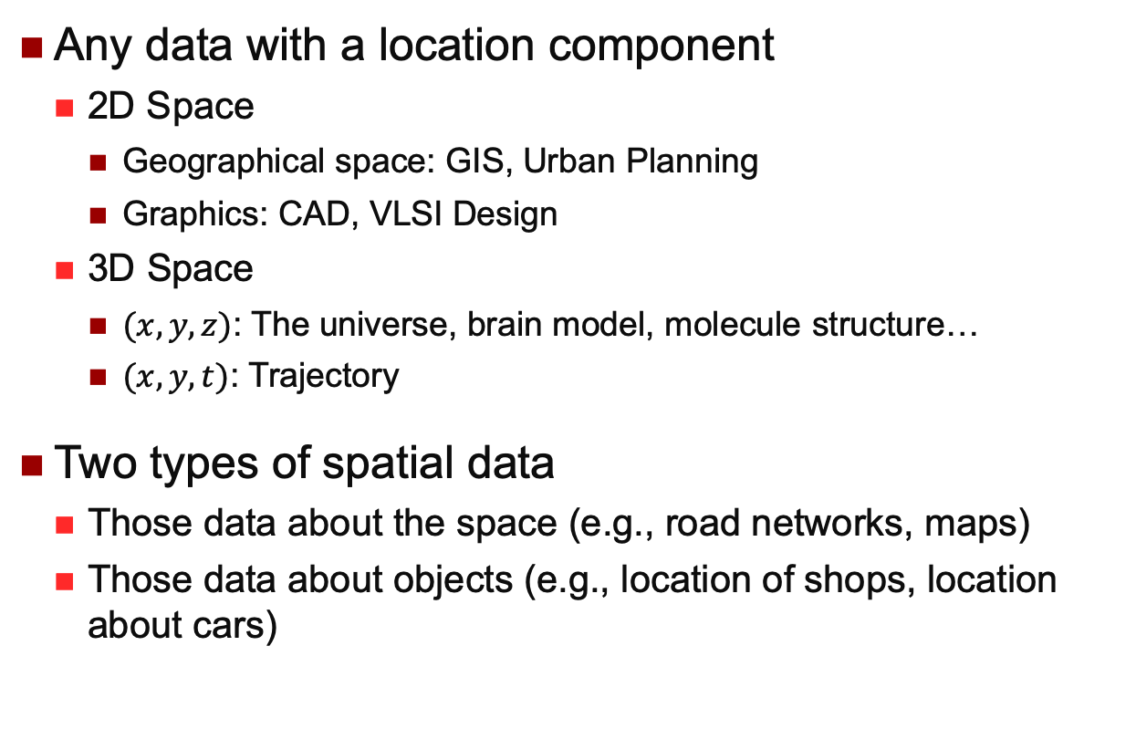
Spatial Data
Any data with a location component
2D Space
Geographical space: GIS, Urban Planning
Graphics: CAD, VLSI Design
3D Space
$(x,y,z)$: The universe, brain model, molecule structure…
$(x,y,t)$: Trajectory
Two types of spatial data
Those data about the space (e.g., road networks, maps)
Those data about objects (e.g., location of shops, location about cars)

Slide 9
More Spatial Data
Natural Area Data
Soil types, land use (industrial, agriculture, zoning etc), vegetation, water (rivers, ponds etc)
Manmade Area Data
Political and administrative boundaries, school districts, emergency service areas, land records data (lot boundaries, zoning, easements)
Network Data
Utilities (phones, sewers, water, electricity etc)
Roads (centrelines, curb lines, intersections, lights)

Slide 10
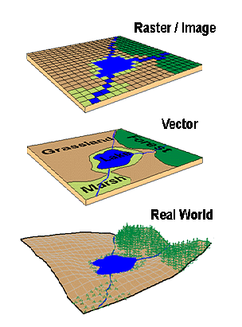
Modelling Spatial Data

Slide 11
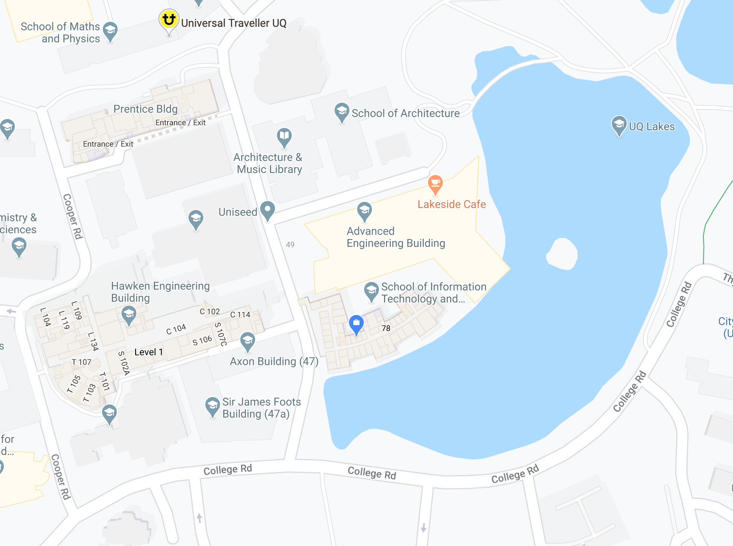
Vector Data
A spatial object is described by a sequence of points
Defined using geometric data types
Points, Lines and Polygons / Region
Work with coordinates
Advantages
Suitable for processing & manipulation
More compact, better rendering quality
Query by spatial relationships
Disadvantages
Continuous data is poorly stored and displayed

Slide 12
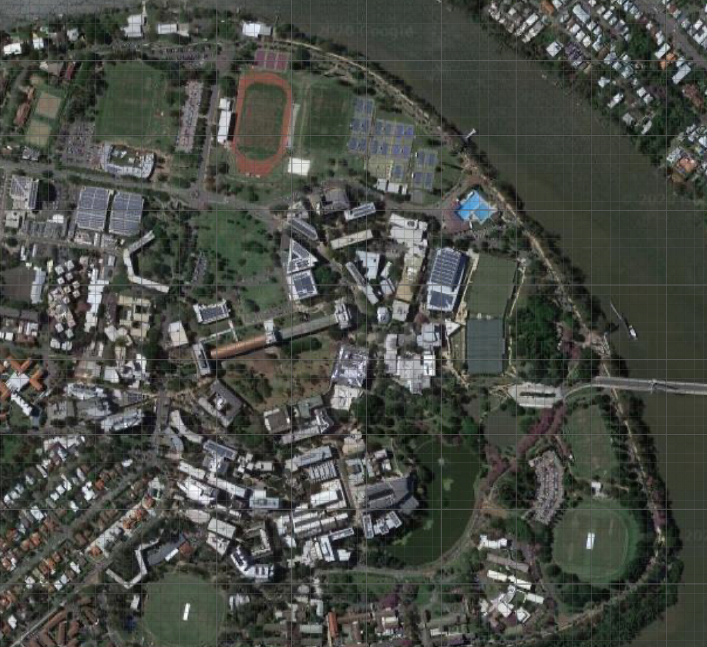
Raster Data
A spatial object is described by a set of pixels
E.g., satellite imagery, remote sensing
Work with pixels
Advantages
Suitable for display
Query by colour, texture, etc.
Efficient for some type of processing
Continuous information like
Temperature / Elevation / Humidity
Census / Health / Employment
Map Algebra^{[1]}
Disadvantages
Pixelated look
Hard to display linear features and paths
Hard to perform topology rules
Large data size

Slide 13
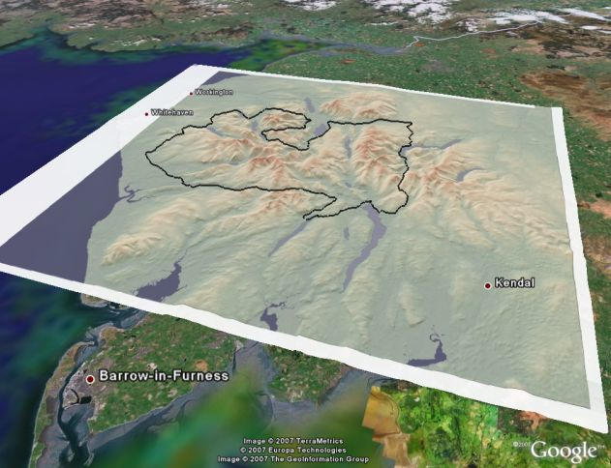
Vector vs Raster Data
Different representation of same data
Suitability application-dependent
Mutually convertible
Rasterization
Vectorization
Often used together
E.g., overlay satellite image, road network, elevation data etc.
Hybrid mode for Google Earth / Google Map
We deal with the vector data in spatial databases

Slide 14
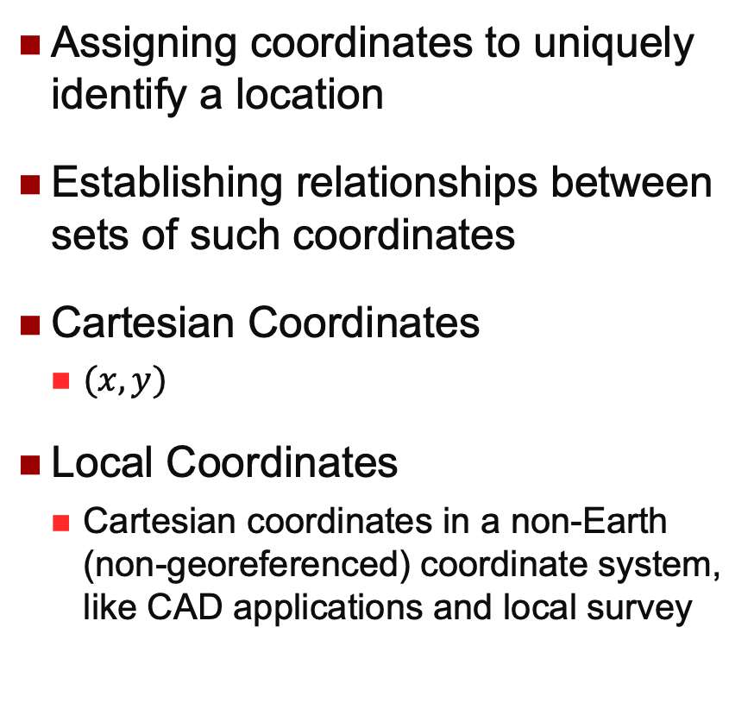
Coordinate Systems
Assigning coordinates to uniquely identify a location
Establishing relationships between sets of such coordinates
Cartesian Coordinates
$(x,y)$
Local Coordinates
Cartesian coordinates in a non-Earth (non-georeferenced) coordinate system, like CAD applications and local survey

Slide 15
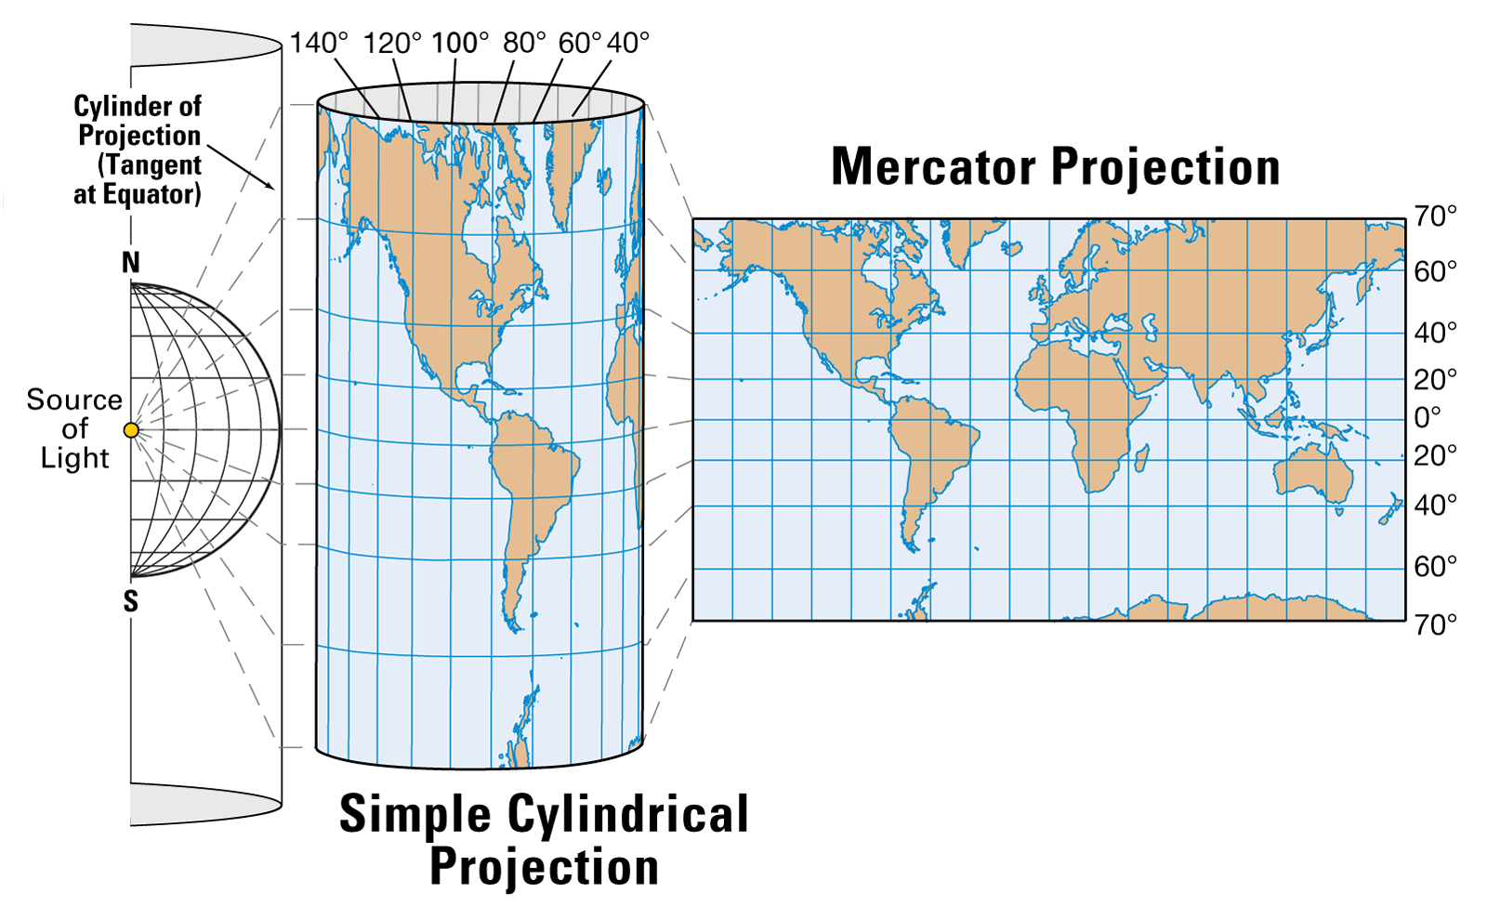
Geographical Coordinate Systems
Map Projection
Creating a 2D representation of a 3D earth model
Commonly used map projections
Mercator
Developed by Gerhardus Mercator, a Flemish Cartographer, in 1569, and the flat map of the world in UTM are found in every school class room

Slide 16
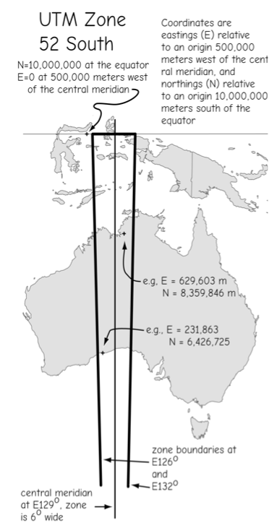
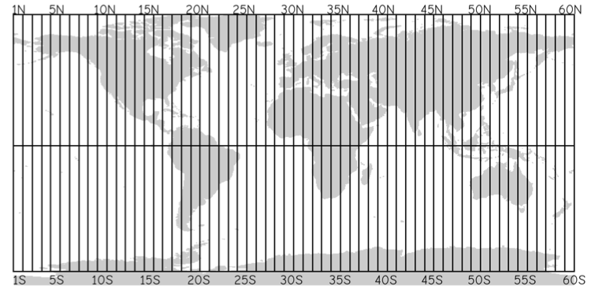
Geographical Coordinate Systems
Map Projection
UTM (Universal Transverse Mercator)
Cartesian Coordinate
60 Zones, each 6 degree of longitude
Unit in meter

Slide 17
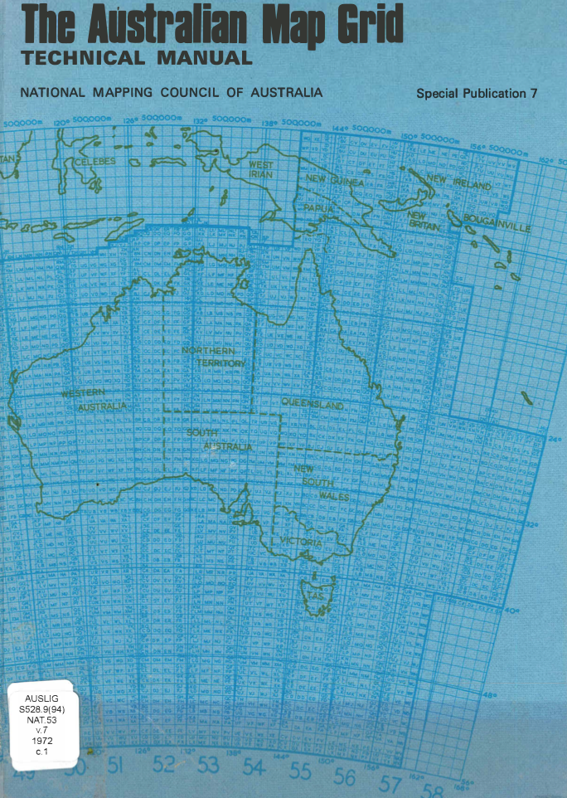
Geographical Coordinate Systems
Map Projection
UTM (Universal Transverse Mercator)
Badly distorts Greenland, Alaska, and Australia.
AMG (Australian Map Grid)
UPS (Universal Polar Stereographic)

Slide 18
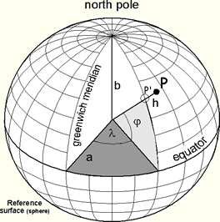
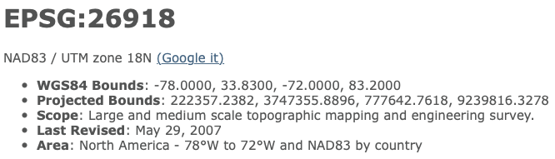
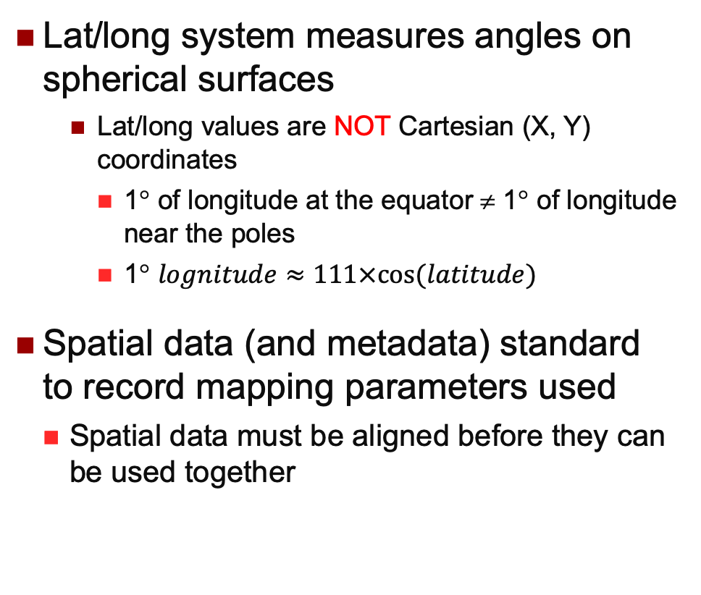
Geographical Coordinate Systems
Lat/long system measures angles on spherical surfaces
Lat/long values are NOT Cartesian (X, Y) coordinates
1° of longitude at the equator ≠ 1° of longitude near the poles
1° $lognitude≈111×cos⁡(latitude)$
Spatial data (and metadata) standard to record mapping parameters used
Spatial data must be aligned before they can be used together

Slide 19
Spatial Data Acquisition
There are many publically available spatial datasets
Government sources, and other providers such as Google
http://www.spatial-data.brisbane.qld.gov.au
Open Street Map / Near Map
Mash-up can be used
Meta-data is important, and so is data provenance
Generating new data
Remote sensing
Field data
Survey data
GPS devices
Crowd Sourcing

Slide 20
Remote Sensing
camera
Change of scale
Plane of photograph
A
B
D
Ground plane
C

Slide 21
Spatial Data Accuracy
Accuracy – how accurate is the data (i.e., how close the recorded location of a spatial feature is to its ground location)
Scale: the ratio between distance on a map and the corresponding distance on the earth
Scale is 1:10,000, meaning that 1 unit of measurement on the map represents 10,000 of the same units on the earth's surface
Resolution: the size of the smallest feature that can be represented in a surface
When scale decreases, resolution decreases too
Precision: how exactly the location is recorded (i.e., # of digits)
Errors can be introduced from many sources, from data capturing, data editing and data simplification, and data processing operations

Slide 22
Spatial DBMS
A spatial database system is a database system
Without non-spatial data, spatial data is meaningless in real-life
It offers spatial data types in its data model and the query language
It supports spatial data types in its implementation, providing at least spatial indexing and efficient algorithms for spatial join queries and other types of queries
Retrieve the data without scanning the whole set
Join the objects without full cartesian product

Slide 23
Alternative Names
AM/FM System (80s)
Automated Mapping and Facilities Management
Associated with public utilities like gas, electric, water and telecommunications
GIS (Geographical Information System)
Pictorial (or Image) Database Systems
Remote sensing by satellite, computer tomography in medical
Land Information Systems
Natural Resources Information Systems
Spatial Data Management (or Handling) System
Object-Relational Database Systems
Oracle has many types of data cartridges, including one for spatial data
New data types, procedures, indexes, queries,…
Spatial, Text, Image, Time series

Slide 24
GIS and Spatial Databases
GIS Applications
Front End
Data capture, editing, conversion, conflation
Map generation
Image processing
Data analysis (in application areas)
Use both raster and vector
Spatial DBMS
Back End
Integrated management of spatial and non-spatial data
Database support expected in a RDBMS, independent from applications
RDBMS-comparable performance

Slide 25
SDBMS is a Multidiscipline Area
Cartography
Display of visual information (or, you can call it visualization)
Computer Science
Databases, Computer Graphics, Image Processing, Machine Learning
Geography
Spatial Analysis
Mathematics
Geometry, Graph Theory
Statistics
Models, Analysis of error
Photogrammetry, remote sensing, surveying…

Slide 26
History
London 1854, Dr John Snow
The father of epidemiology
Paper Mapping Analysis with Cholera Clusters
Illustrate how cases of cholera were centered around a water pump
City layer, Water pump layer, Cholera cluster layer,…
The beginning of spatial analysis

Slide 27
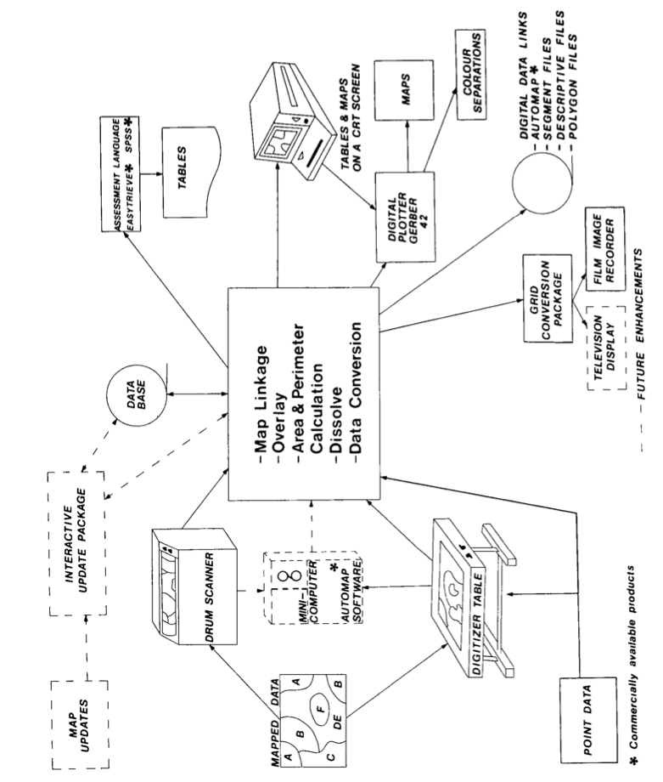
History
Canada: Geographic Information System (60s)
Manual analysis was almost as costly as the surveys
Produced maps which indicated the capability of land to sustain agriculture, forestry, recreation and wildlife
Assisted in the development of regulatory procedures for land-use management and resource monitoring
Overlay, Measurement, and Digitizing/Scanning.

Slide 28
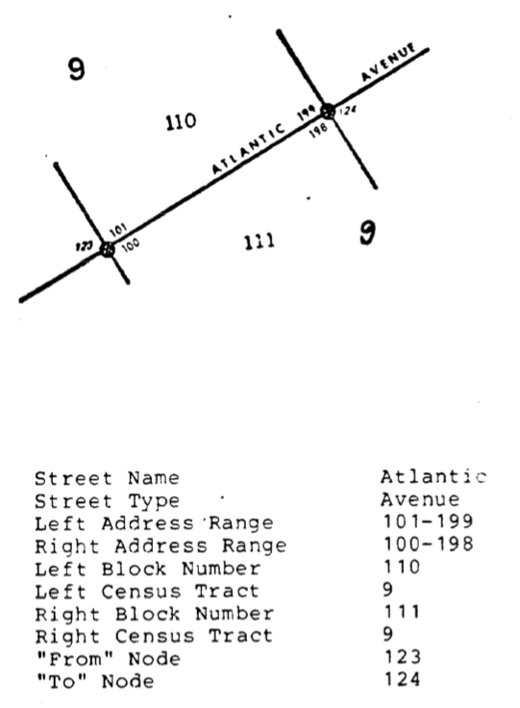
History
American Bureau of Census
1970 census (Only urban areas)
Digital input of the 1970 Census
GBF-DIME (Geographic Base File – Dual Independent Map Encoding)
Digitize Census boundaries, roads and urban areas
Intersections, streets, and blocks became analogous to points, lines, and polygons
Street address & UTM coordinate
Topology + Direction
TIGER (Entire country, 1990 census)
Topologically Integrated Geographic Encoding and Referencing system

Slide 29

History
ODYSSEY project (the 70’s)
Harvard Laboratory for Computer Graphics and Spatial Analysis
SYMAP: Vector models, mapping on a line printer
ESRI: Arc/Info
Environmental Systems Research Institute

Slide 30
History
Australia
From CSIRO: SIRO-DBMS (SDM) (in the late 80’s)
Many small GIS companies
Main-stream DB vendors (late 1990’s)
Oracle, Informix, IBM (DB2), Microsoft (MapPoint)
And for the last ten years, Google and many Internet companies…

Slide 31
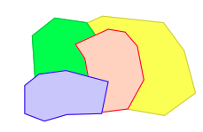
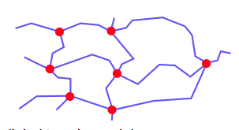
Spatial Data Models
Objects in space (Object-based)
Single objects
Point (User, City, POI)
Line / Polyline (River, Cable, Road)
Polygon or Region (Forest, Lake, City)
Spatially related collections of objects
Partition (Land use, districts, land ownership)
Network (Roads, rivers, electricity, phone)
4
Area-ID | Dominant Tree | Area
FS1 | Pine | [(0,2), (4,2), (4,4), (0,4)]
FS2 | Fir | [(0,0), (2,0), (2,2), (0,2)]
FS3 | Oak | [(2,0), (4,0), (4,2), (2,2)]
Pine
2
Fir
Oak
0
2
4

Slide 32
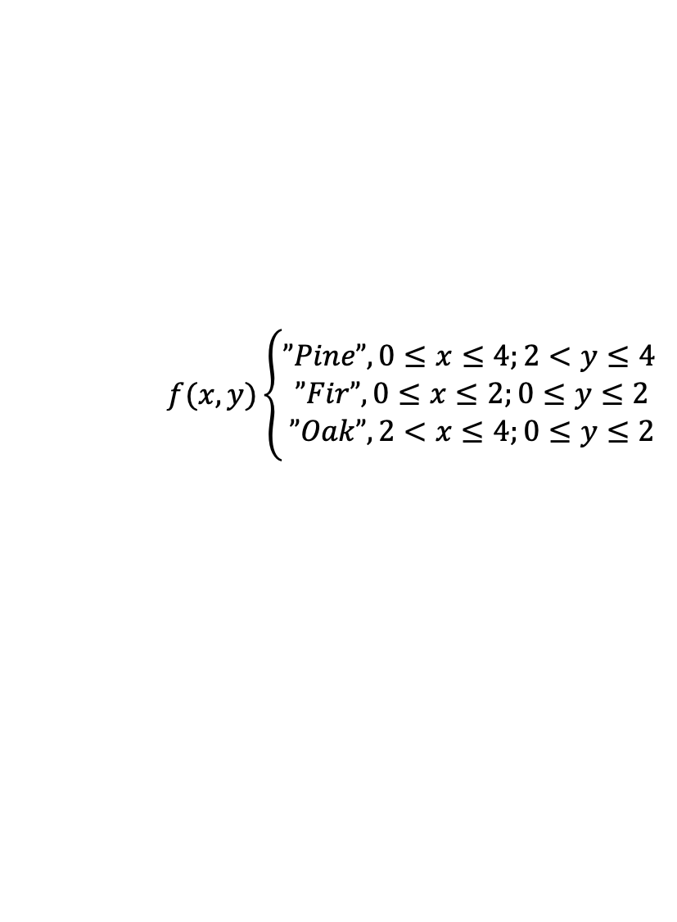
Spatial Data Models
Space itself (Field-based)
The spatial extent, Euclidian space or other types of spaces (frame/location references, dimension#, distance measures)
Framework: The space, coordinate, and partition
Field Function: Maps each partition to its attribute value
Field Operation: Addition, Composition
Local, Focal, Zonal
More related to the raster image
4
Pine
$$f(x,y)\left\{\begin{aligned}”Pine”, 0≤x≤4;2<y≤4 \\ ”Fir”, 0≤x≤2;0≤y≤2 \\ ”Oak”, 2<x≤4;0≤y≤2\end{aligned}\right.$$
2
Fir
Oak
0
2
4

Slide 33
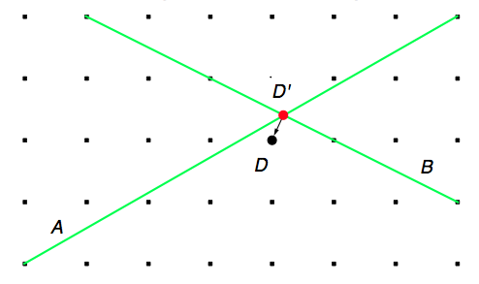
The Underlying Space
Euclidean space is continuous real number
Computer numbers are finite and discrete, with limited approximation
Problems: numerical rounding errors and topological inconsistency and degeneracy
Is D on A?
Is D contained in the area below A & B?
A practical solution: for two points a and b, never ask if a=b; instead, test if distance(a, b) < ε

Slide 34
Geometry in Data Model
To represent real-world spatial objects using database objects (based on the data model)
Create a table to store the land use information
Relational data model
BLOB
Binary Large OBject
“The thing that ate Cincinnati, Cleveland, or whatever”
landuse(area: BLOB, type: string)
Not searchable, Cannot be indexed, No operation…

Slide 35
Geometry in Data Model
To represent real-world spatial objects using database objects (based on the data model)
Create a table to store the land use information
Relational data model
Table
landuse(areaID: number, type: string);
polygon(areaID: number, pntID: number, x: number, y: number)
Area-ID | pntID | x | y
FS1 | 0 | 0 | 2
FS1 | 1 | 4 | 2
FS1 | 2 | 4 | 4
FS1 | 3 | 0 | 4
… | … | … | …
Area-ID | Dominant Tree
FS1 | Pine
FS2 | Fir
FS3 | Oak

Slide 36
Geometry in Data Model
To represent real-world spatial objects using database objects (based on the data model)
Create a table to store the land use information
Spatial Data Model
landuse(area: polygon, type: string)
Data Type
Valid Values
Supported Operations

Slide 37

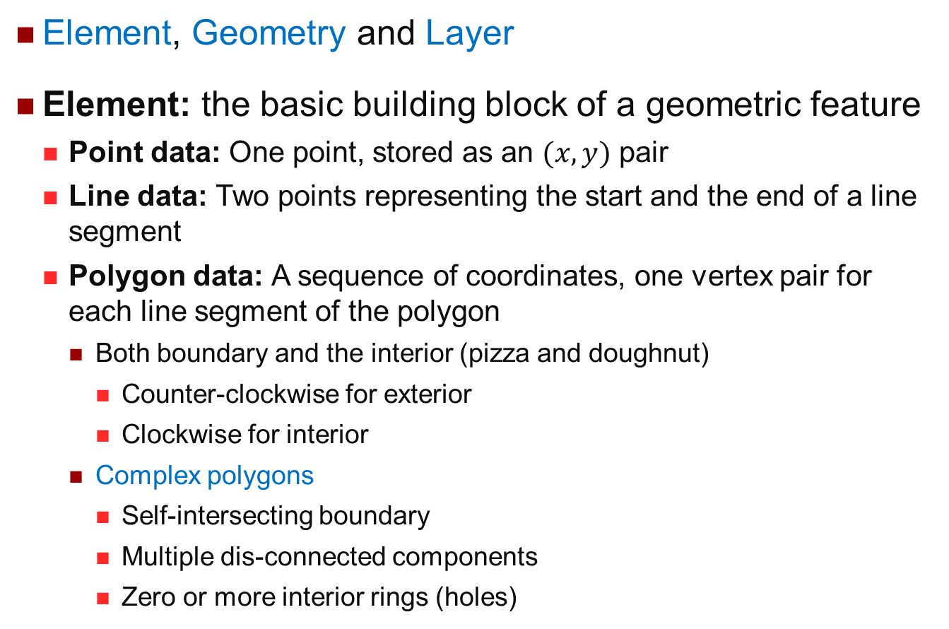
Spatial Data Model in Oracle
Element, Geometry and Layer
Element: the basic building block of a geometric feature
Point data: One point, stored as an $(x, y)$ pair
Line data: Two points representing the start and the end of a line segment
Polygon data: A sequence of coordinates, one vertex pair for each line segment of the polygon
Both boundary and the interior (pizza and doughnut)
Counter-clockwise for exterior
Clockwise for interior
Complex polygons
Self-intersecting boundary
Multiple dis-connected components
Zero or more interior rings (holes)

Slide 38
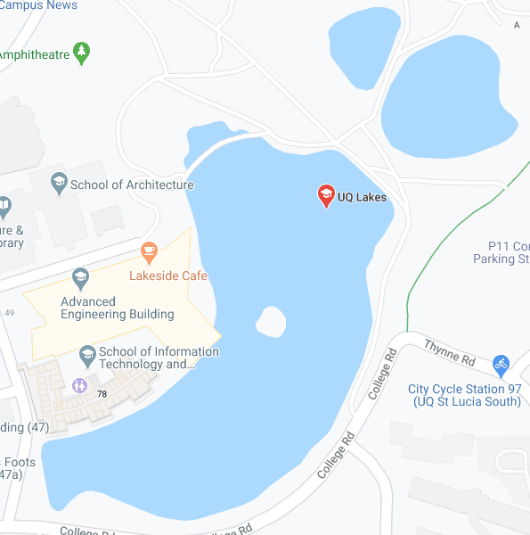
Spatial Data Model in Oracle
Geometry: representation of a user’s spatial feature, modelled as an ordered set of elements
Each geometry has a unique ID, and can be associated with a set of attributes
A geometry might describe a lake
A polygon with nested polygons for islands
Attributes such as lake name, water capacity, fauna, flora, …

Slide 39
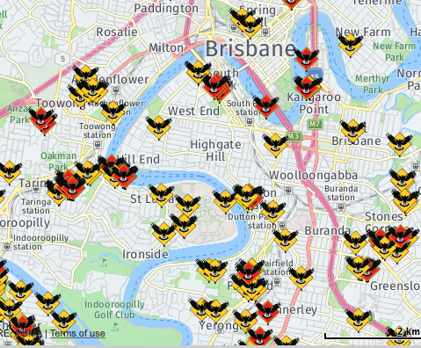
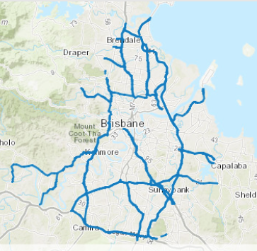
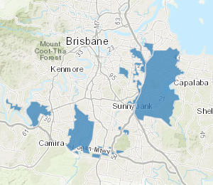
Spatial Data Model in Oracle
Layer: a collection of geometries having the same attribute set
Examples: soil types, road network, political boundaries, population density, crops, weather conditions,…
Magpie Swooping
Transport Noise Corridor Overlay
Koala Habitat Areas

Slide 40
Data Model in DB2
Ellipse
Point
polygon
Circle
Multipoint
Linestring
Multi-linestring
Rectangle
Multipolygon
Square

Slide 41
Data Model in PostGIS
Spatial data types are organized in a type hierarchy
Each sub-type inherits the structure (attributes) and the behaviour (methods or functions) of its super-type.

Slide 42
Spatial Relationships
Topological
E.g., inside, intersect, adjacent
Invariant under translation such as rotation and scaling
Directional
E.g., above, left, north of
May change with rotation
Metric
E.g., distance
May change with scaling

Slide 43
Defining Spatial Relationship
Q: How to define a spatial relationship precisely?

Slide 44
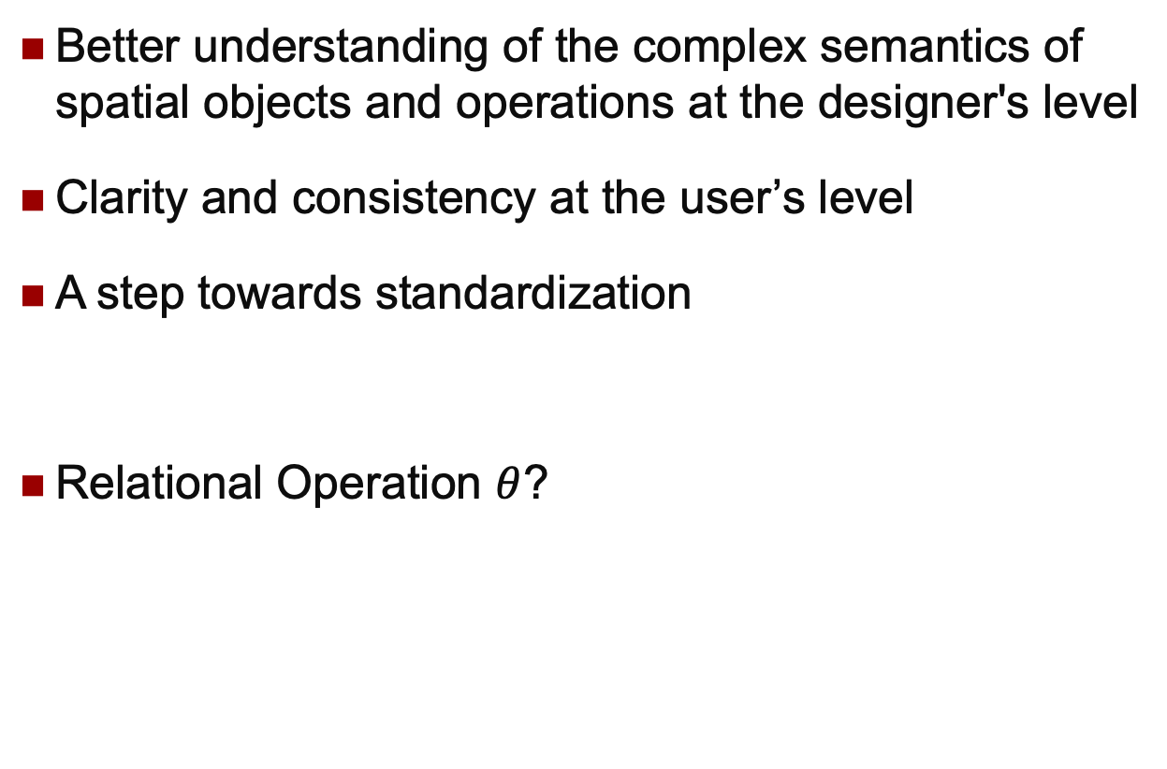
Formal Definitions
Better understanding of the complex semantics of spatial objects and operations at the designer's level
Clarity and consistency at the user’s level
A step towards standardization
Relational Operation $θ$?

Slide 45
The 9-Intersection Matrix
A_{b}: boundary
A_{i}: interior
A_{e}: exterior
Egenhofer, M.J.; Herring, J.R. (1990). "A Mathematical Framework for the Definition of Topological Relationships"

Slide 46
The 8 Spatial Relationships (I)
Complete, and Mutually Exclusive.
A
A
B
A
B
A
B
B
disjoint
contain
inside
equal
A
A
A
A
B
B
B
B
meet
cover
covered_by
overlap

Slide 47
The 8 Spatial Relationships (I)
A
A
B
A
B
A
B
B
disjoint
contain
inside
equal
disjoint
contain
inside
equal

Slide 48
The 8 Spatial Relationships (I)
meet
cover
covered_by
overlap
A
A
A
A
B
B
B
B
meet
cover
covered_by
overlap

Slide 49
Operations for Spatial Queries
Basic Spatial Operations
Selection, Projection, Amalgamation
Containment, Region, Intersection, Overlay, Fusion, Windowing, Clipping, Centre, Boundary
Area, Perimeter, Distance
Other Spatial Operations
Nearest Neighbours, Similarity Search, Skyline Queries
Complex Spatial Queries
Multiple predicates/operations, spatial sub-queries

Slide 50
Projection Query
corn district 1
district 1
wheat district 3
corn district 2
district 2
district 3
wheat district 4
district 4

Slide 51
Selection Query
corn district 1
wheat district 3
corn district 2
wheat district 3
wheat district 4
wheat district 4

Slide 52
Containment Query
Given a spatial object O, find all objects in the map that completely contain O.
When O is a point, the query is called Point Query
O
O
O is a polygon (O is the green one) and the red one is the query result.
O is a point (the green dot).

Slide 53
Region Query
Given a region R, find all objects in the map that intersect R
When R is a rectangle, the query is called Window Query
R
R

Slide 54
Overlapping Query
corn district 1
corn district 1
corn district 2
corn district 2
wheat district 3
wheat district 4
wheat district 4

Slide 55
Clipping Query
corn district 1
corn
wheat district 3
corn district 2
corn
wheat district 4
wheat

Slide 56
Fusion/Amalgamation Query
corn district 1
corn
wheat district 3
corn district 2
wheat
wheat district 4
…important applications in spatial OLAP and spatial data mining
Notes:
Rainfall

Slide 57
Overlay Query
corn
wheat
vegetable
grass
Wheat/soil1
soil2
soil1
soil3
soil4

Slide 58
Spatial Query Language
CREATE TABLE ROADS
(Road_id NUMBER,
Road_name CHAR(30),
Road_type CHAR(30),
Route LINE_SEGMENT);
CREATE TABLE REGIONS
(Region_id NUMBER,
Region_name CHAR(30),
Region_zip NUMBER,
Region_Type CHAR(30),
Location POLYGON);

Slide 59
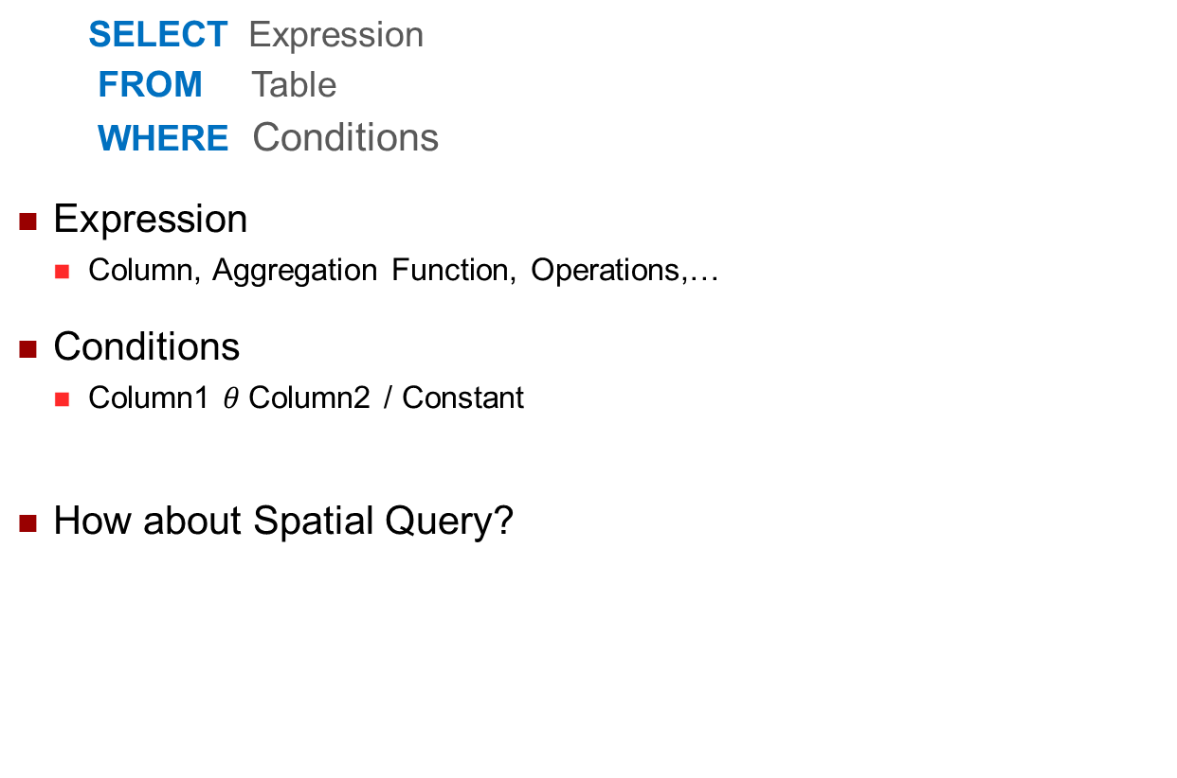
Denoting SDT Values Input
SELECT Expression
FROM Table
WHERE Conditions
Expression
Column, Aggregation Function, Operations,…
Conditions
Column1 $θ$Column2 / Constant
How about Spatial Query?

Slide 60
Denoting SDT Values Input
Problem: “Brisbane” vs. the geometry of Brisbane
Define named atomic data type values
DEFINE Brisbane
ELEMENT SELECT boundary
FROM city // city(name, boundary, ...)
WHERE name = “Brisbane”;
Use spatial constants
WHERE boundary inside POLYGON(100, 102.3; 1.5, 107; ….);

Slide 61
Fundamental DB Operations (I)
Selection
SELECT *
FROM river // river(name, route, …)
WHERE route intersect PacificHighway;
Join
SELECT river.name, road.name
FROM river, road // road(name, route, …)
WHERE river.route intersect road.route;

Slide 62
Fundamental DB Operations (II)
Function applications
SELECT river.name, road.name,
intersection(river.route, road.route)
FROM river, road
WHERE river.route intersect road.route;
SELECT river.name,
length(intersection(river.route, Queensland))
FROM river
WHERE river.route intersect Queensland;

Slide 63
Fundamental DB Operations (III)
Other set operations
SELECT fusion(area), round(amount/100)*100
FROM rainfall //rainfall(area, date, amount)
WHERE date = ‘12/1/2011’
GROUP BY round(amount/100);

Slide 64
SDBMS Architectures
Requirements
Representations for spatial data types
Procedures for spatial operations, including spatial join algorithms
Spatial index structures, and access operations
Spatial query optimizer with cost functions & statistics
Spatial query language, incorporating spatial data types, operations and graphical I/O
Three generations
Using file systems; using standard RDBMS; integrated systems

Slide 65
1st Generation: Using File System
GIS Tools
Problems:
No high level data definition
No flexible querying
No DBMS support (eg, TM)
Proprietary GIS API
GIS Data
Engine
Proprietary GIS API
File System
Spatial data stored in file system
Geometry, indexes, and attributes

Slide 66
2nd Generation: Using RDBMS (I)
GIS Tools
Dual Architecture:
Easy implementation
Efficient for spatial or aspatial queries
But not both!
Proprietary GIS API
Integration
Layer
SQL
Proprietary GIS API
Standard
RDBMS
Spatial
Subsystem
Aspatial data stored in a RDBMS
Spatial data stored in a GIS system
Attributes
Geometry, indexes

Slide 67
2nd Generation: Using RDBMS (II)
Layered Architecture:
Representing SDT as a set of tuples, one tuple per point or line segment; or as long fields (ie, uninterpreted byte strings).
Mapping SDT into numbers and using B-Tree as index.
Right step towards integrated system
Poor spatial performance.
GIS Tools
SQL
GIS Data
Engine
SQL
Standard
RDBMS

Slide 68
3rd Generation: Part of ORDBMS
Integrated architecture:
Future direction
Possibility for users to extend the system
Now a mature technology
Performance still a problem for for complex queries
Transaction Management is hard (for long running transactions)
GIS Tools
SQL
Spatial data stored as User Defined Data Types in DBMS with other data
ORDBMS

Slide 69
SDBMS Implementation
Continues space vs Discrete computer numbers
High level query language (eg, SQL-like)
Spatial query processing (at least spatial join)
Spatial data access methods (indexing)
Other DBMS issues
Query optimization
Transaction management
Integrity and consistency
Parallel processing
Spatial data warehousing and data mining

Slide 70
Summary
Spatial DBMS is still a DBMS
Data types and query languages may look different, but are still the same in essence
Just need to think data types in its intrinsic meaning
If your job is to develop a database system to manage spatial data, this lecture gives you a good example
What about images? Videos? Graphs?
You need to understand the concepts introduced
Spatial data, data types, operations, queries

